Slide 1
Network : Routing Algorithm
Jae Hyeon Kim

Slide 2
Reference
William Stalling, Data and Computer Communications 10/E, Prentice Hall

Slide 3
OSPF
IGP(Interior Gateway Protocol) in TCP/IP networks
Documented with RFC 2328
Replaced Routing Information Protocol (RIP)
Computes a route through the Internet that incurs the least cost based on a user-configurable metric of cost
Uses link state routing algorithm
Each router keeps list of state of local links to network
Transmits update state info to all routers
Little traffic as messages are small and not sent often
Uses least cost based on User cost metric
E.g. Dijkstra’s algorithm

Slide 4
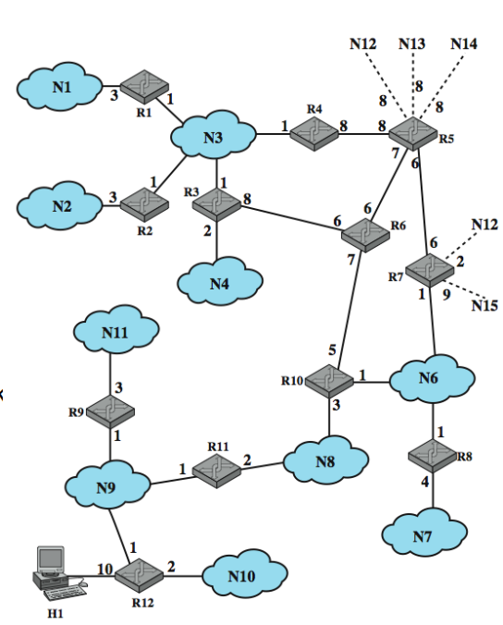
Sample OSPF AS
Topology stored as directed graph
Vertices or nodes
Router
network
Edges
Connect two router
Connect router to network

Slide 5
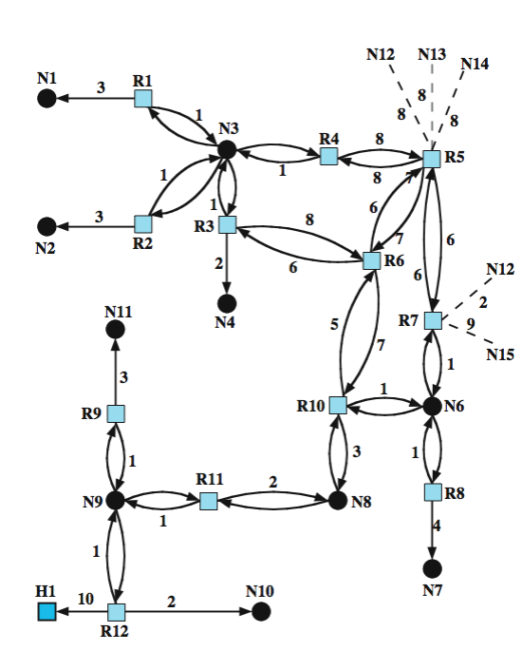
Directed Graph of AS

Slide 6
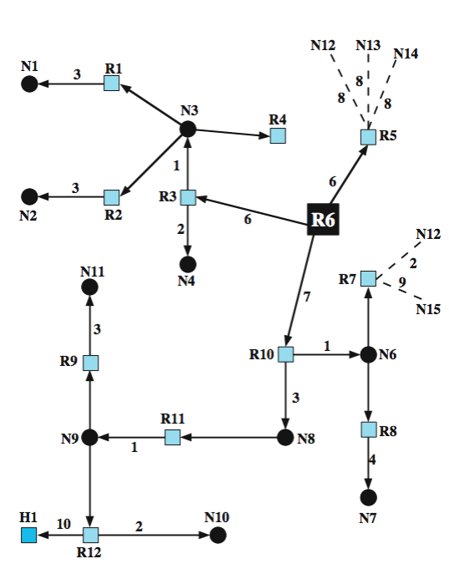
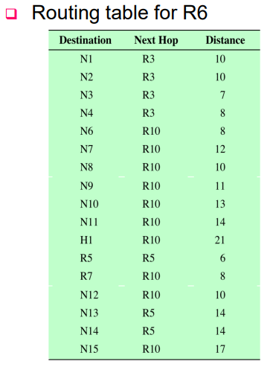
SPF Tree for Router 6

Slide 7
Least Cost Algorithms
Basis for routing decisions
Minimize hop with each link cost 1
Have link cost value inversely proportional to capacity
Defines cost of path between two nodes as sum of costs of links traversed
Network of nodes connected by bi-directional links
Link has a cost in each direction
For each pair of nodes, find path with least cost
Link costs in different directions may be different
Alternatives: Dijkstra of Bellman-Ford algorithms

Slide 8
Dijkstra’s Algorithm
Find shortest paths from given source to all other nodes, by developing paths in order of increasing path length
N = set of nodes in the network
S = source node
T = set of nodes so far incorporated by the algorithm
W(I, j ) = link cost from node i to node j
w(i, i) = 0
w(i, j) = ∞ if the two nodes are not directly connected
w(i, j) >= 0 if the two nodes are directly connected
L(n) = cost of least-cost path from node s to node n currently known
at termination, L(n) is cost of least-cost path from s to n

Slide 9
Dijkstra’s Algorithm Method
Step 1 [initialization]
T = {s} set of nodes so far incorporated consists of only source node
L(n) = w(s, n) for n ≠ s
initial path costs to neighboring nodes are simply link costs
Step 2 [get next node]
find neighboring node not in T with least-cost path from s
incorporate node into T
also incorporate the edge that is incident on that node and a node in T that contributes to the path
Step 3 [update least-cost paths]
L(n) = min[L(n), L(x) + w(x, n)] for all n T
if latter term is minimum, path from s to n is path from s to x concatenated with edge from x to n
Algorithm terminates when all nodes have been added to T

Slide 10
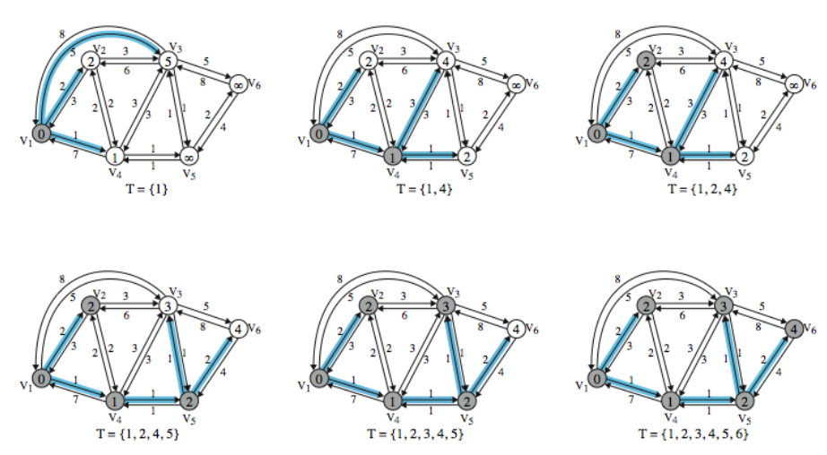
Example of Dijkstra’s Algorithm

Slide 11
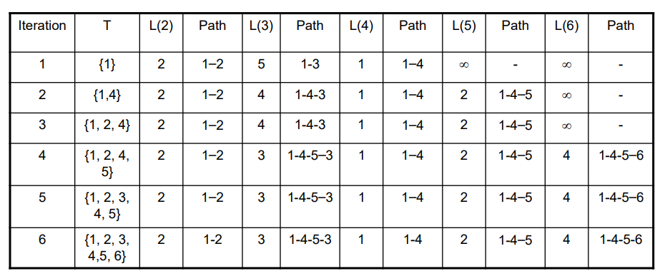
Result of Example Dijkstra’s Algorithm

Slide 12
Bellman-Ford Algorithm Definitions
Idea
find shortest paths from given node subject to constraint that paths contain at most one link
find the shortest paths with a constraint of paths of at most two links
S = source node
W(I, j) = link cost from node I to node j
w(i, i) = 0
w(i, j) = ∞ if the two nodes are not directly connected
w(i, j) >= 0 if the two nodes are directly connected
Lh (n) = cost of least-cost path from s to n under constraint of no more than h links
h = maximum # of links in path at current stage of the algorithm

Slide 13
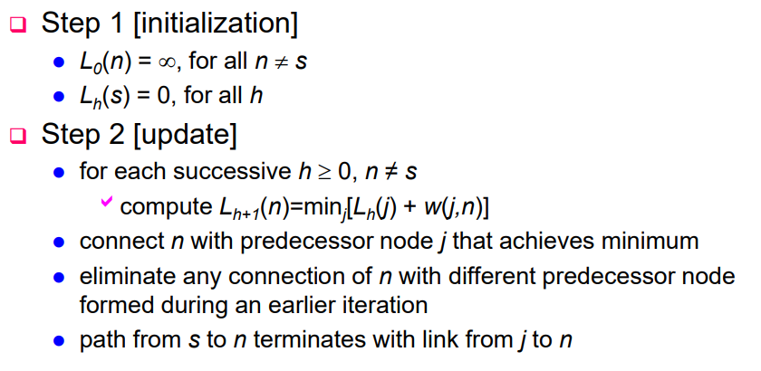
Bellman-Ford Algorithm Method

Slide 14
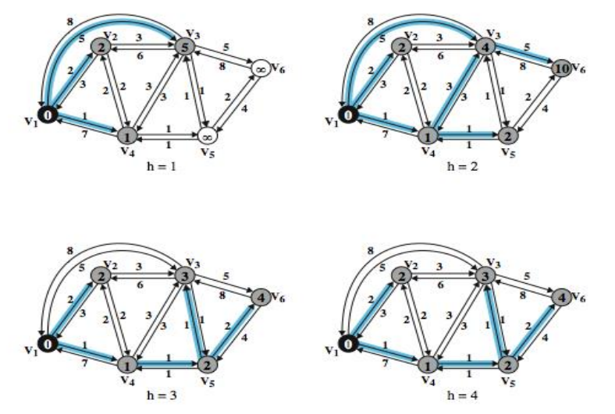
Bellman-Ford Algorithm Method

Slide 15
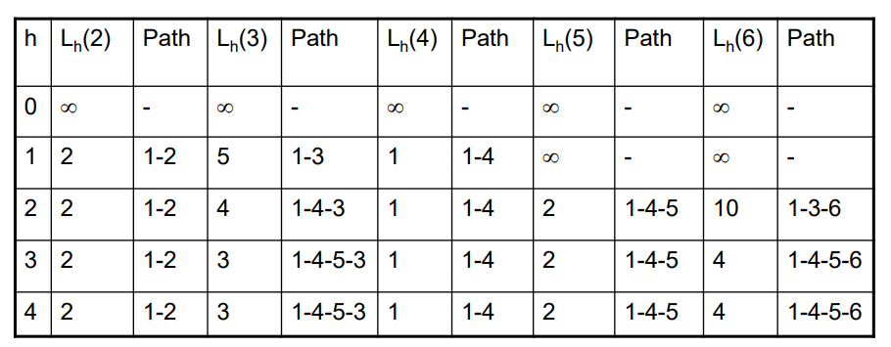
Bellman-Ford Algorithm Method

Slide 16
Comparison
Results from two algorithms agree each other
Bellman-Ford
Route calculation for node n involves knowledge of link cost to all neighbor nodes plus total cost to each neighbor from s (step 2)
Each node can maintain set of costs and paths for other node
Can exchange information with direct neighbors
Can update costs and paths based on information from neighbors and knowledge of link costs
Dijkstra
Each node needs complete topology
Must know link costs of all links in network (step 3)
Must exchange information with all other nodes

Slide 17
Evaluation
Dependent on
Processing time of algorithms
Amount of information required from other nodes
Implementation specific
Both converge under static topology and costs
Both converge to same solution
If link costs change, algorithms will attempt to catch up
If link costs depend on traffic which depends of routes chosen, then feedback
If may result in instability

